Slide 1
Lesson objective: to explore the poem Harmonium through questioning and analysing imagery.
Year 9 Unit: Poetry of Conflict
Looking at the conflict within family relationships in the poem ‘Harmonium’ by Simon Armitage

Slide 2
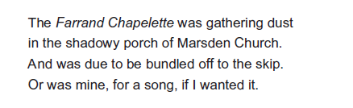
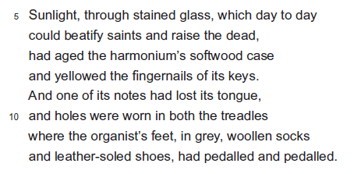
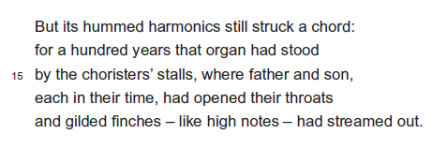
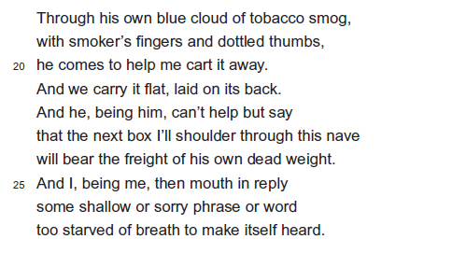
Harmonium
Lesson objective: to explore the poem Harmonium through questioning and analysing imagery.
As we read the poem, think about what you learn about the relationship presented by the poet.

Slide 3
Harmonium
Lesson objective: to explore the poem Harmonium through questioning and analysing imagery.
Memory recall:
What impressions did you get as we read the poem. Write one statement each about:
The narrator;
The setting;
The father;
The instrument;
Any relationship;
He seems to be quite sad.
They do not seem very close.
It is brand new and the narrator is excited about playing it.

Slide 4
Harmonium
Lesson objective: to explore the poem Harmonium through questioning and analysing imagery.
But or Because:
Now swap your statements with a partner. For each statement decide whether you agree with the statement or not.
If you agree, write ‘because’ after it.
If you disagree, write ‘but’ after it.
Now give your reason why you agree or disagree. To give a strong answer try to include a quotation with your explanation.

Slide 5
Harmonium
Lesson objective: to explore the poem Harmonium through questioning and analysing imagery.
He seems to be quite sad.
BECAUSE
The poet makes the narrator describe all the things that are wrong with the harmonium. For example ‘gathering dust’ and ‘shadowy porch’ suggest that the instrument is not looked after which is a sad thing.
It is brand new and the narrator is excited about playing it.
BUT
When the poet says ‘He helped me to cart it away’ we feel as though he just wants to get it out of the church as ‘cart’ seems like a negative verb and sounds quite harsh.

Slide 6
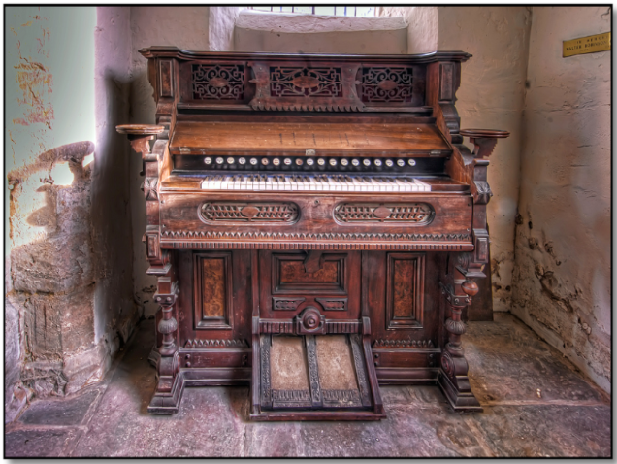
Harmonium
Lesson objective: to explore the poem Harmonium through questioning and analysing imagery.
Exploring IMAGERY in Harmonium:
On your image of the Harmonium, label what we learn about what the instrument looks like.
Draw a line to link the quotation with the correct part of the harmonium.

Slide 7

Imagery
Lesson objective: to explore the poem Harmonium through questioning and analysing imagery.
CAN YOU SPOT ANY POETIC DEVICES IN THESE QUOTATIONS?
‘gathering dust’
‘one of its notes had lost its tongue’
‘Yellowed the fingernails of its keys’
‘holes were worn in both the treadles’
‘aged the harmonium’s soft wood case’
What IMPRESSIONS do you get of the harmonium from these quotations? Why do you think the poet has created this impression? Write your answer in full sentences using quotations to help you explain.

Slide 8
Imagery
Lesson objective: to explore the poem Harmonium through questioning and analysing imagery.
CAN YOU SPOT ANY POETIC DEVICES IN THESE QUOTATIONS?
What IMPRESSIONS do you get of the harmonium from these quotations? Why do you think the poet has created this impression? Write your answer in full sentences using quotations to help you explain.

Slide 9
Imagery
Lesson objective: to explore the poem Harmonium through questioning and analysing imagery.
CAN YOU SPOT ANY POETIC DEVICES IN THESE QUOTATIONS?
What IMPRESSIONS do you get of the harmonium from these quotations? Why do you think the poet has created this impression? Write your answer in full sentences using quotations to help you explain.

Slide 10
Poetic Devices
Lesson objective: to explore the poetic devices in the poem Harmonium and respond to an unseen poem question.
The make of the harmonium and the location of the church make clear this is an event the poet wants us to believe actually happened.
Imagery: unused and neglected.
Unromantic language: suggests being treated like any other rubbish.
Pun: both that he got it cheaply and that he can use it for singing.

Slide 11
Poetic Devices
Lesson objective: to explore the poetic devices in the poem Harmonium and respond to an unseen poem style question.
Suggests atmosphere of the church, perhaps also the pictures in the windows.
Personification: personifies the harmonium – it’s described as an aged person.
Ordinary, everyday description.
Repetition: emphasises the passing of time – the age of the harmonium and the fate of the father later on.

Slide 12
Poetic Devices
Lesson objective: to explore the poetic devices in the poem Harmonium and respond to unseen poem style question.
Onomatopoeia: mimicking the sound of the harmonium emphasised by the alliteration.
Pun: can play a chord and still appeals – narrator uses a number of puns (humorous language) yet doesn’t respond well to his father’s joke at the end.
Lively image: stands out from the ordinariness of the rest of the poem. Interestingly, it reverses the usual order of the simile – does this reflect the relationship?
Thinking of all the generations who’ve sung here leads him to think of his own relationship.

Slide 13
Poetic Devices
Lesson objectives: to explore the poetic devices in the poem Harmonium and respond to an exam style question.
Suggests age and ill-health – links his tobacco stained fingers to the yellowed keys of the Harmonium.
A reference to the way a body is carried in a coffin for a funeral.
Internal rhyme suggests father’s dark humour.
Last two lines rhyme – adding extra emphasis. For all that age and time have done to the harmonium and his father, it is the narrator left speechless and breathless.

Slide 14
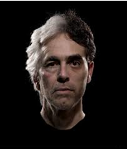
Harmonium
Lesson objective: to explore the poem Harmonium through questioning and analysing imagery.
Exploring relationships in Harmonium:
On the second image given to you, label what we learn about the father and son. Make sure that you support your INFERENCES with quotations from the poem:

Slide 15
Impressions
Lesson objective: to explore the poetic devices in the poem Harmonium and respond to an unseen poem style question.
Quotation:
Inference:
Quotation:
Inference:
The Father
The Son
Quotation:
Inference:
Quotation:
Inference:
Quotation:
Inference:
Quotation:
Inference:
What IMPRESSIONS do you get of the father from these quotations? Evaluate how strong the bond is between father and son?

Slide 16
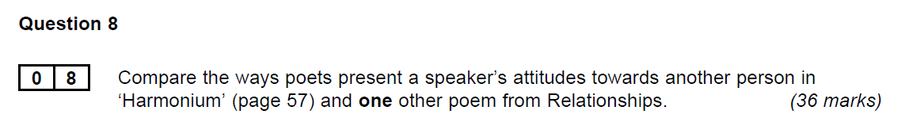
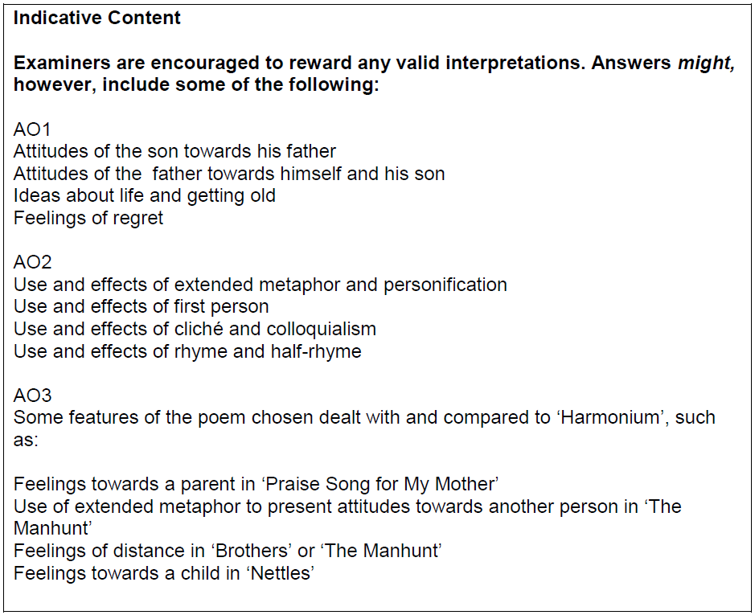
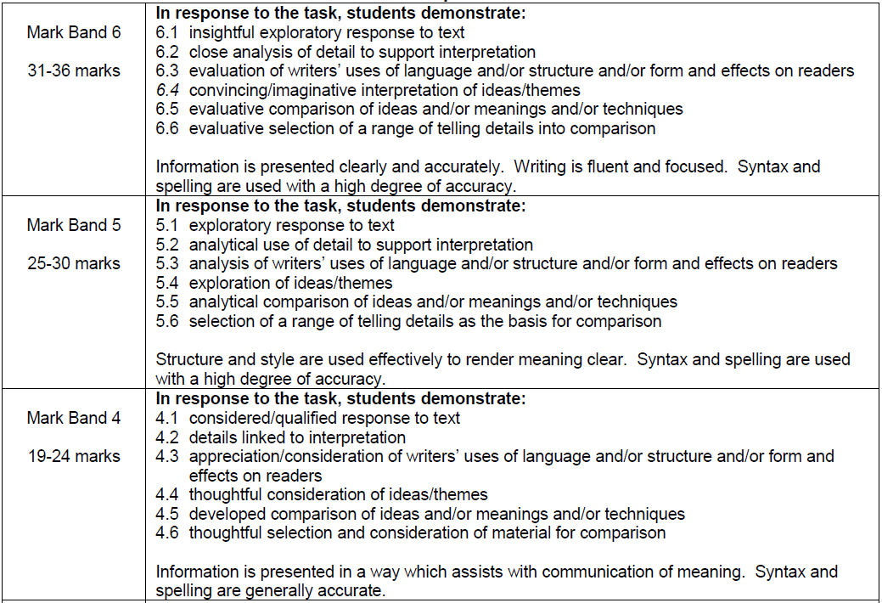
Impressions
Lesson objectives: to explore the poetic devices in the poem Harmonium and respond to an exam style question.

Slide 17
BUT… | BECAUSE…
BUT… | BECAUSE…
BUT… | BECAUSE…
BUT… | BECAUSE…
BUT… | BECAUSE…

